Slide 1
craigslist
Group 5
Diana Choi
Richard Pham
Payton Perchez
Aaron Kwok

Slide 2
What is craigslist?
an American classified advertisement website
created by Craig Newmark
began as an email distribution list about events in SF area
continued to grow as number of subscribers and postings increased
website went live in 1996 as craigslist.org
Typical users
people looking to sell/buy things
people looking for jobs
frequent users in a community/forum

Slide 3
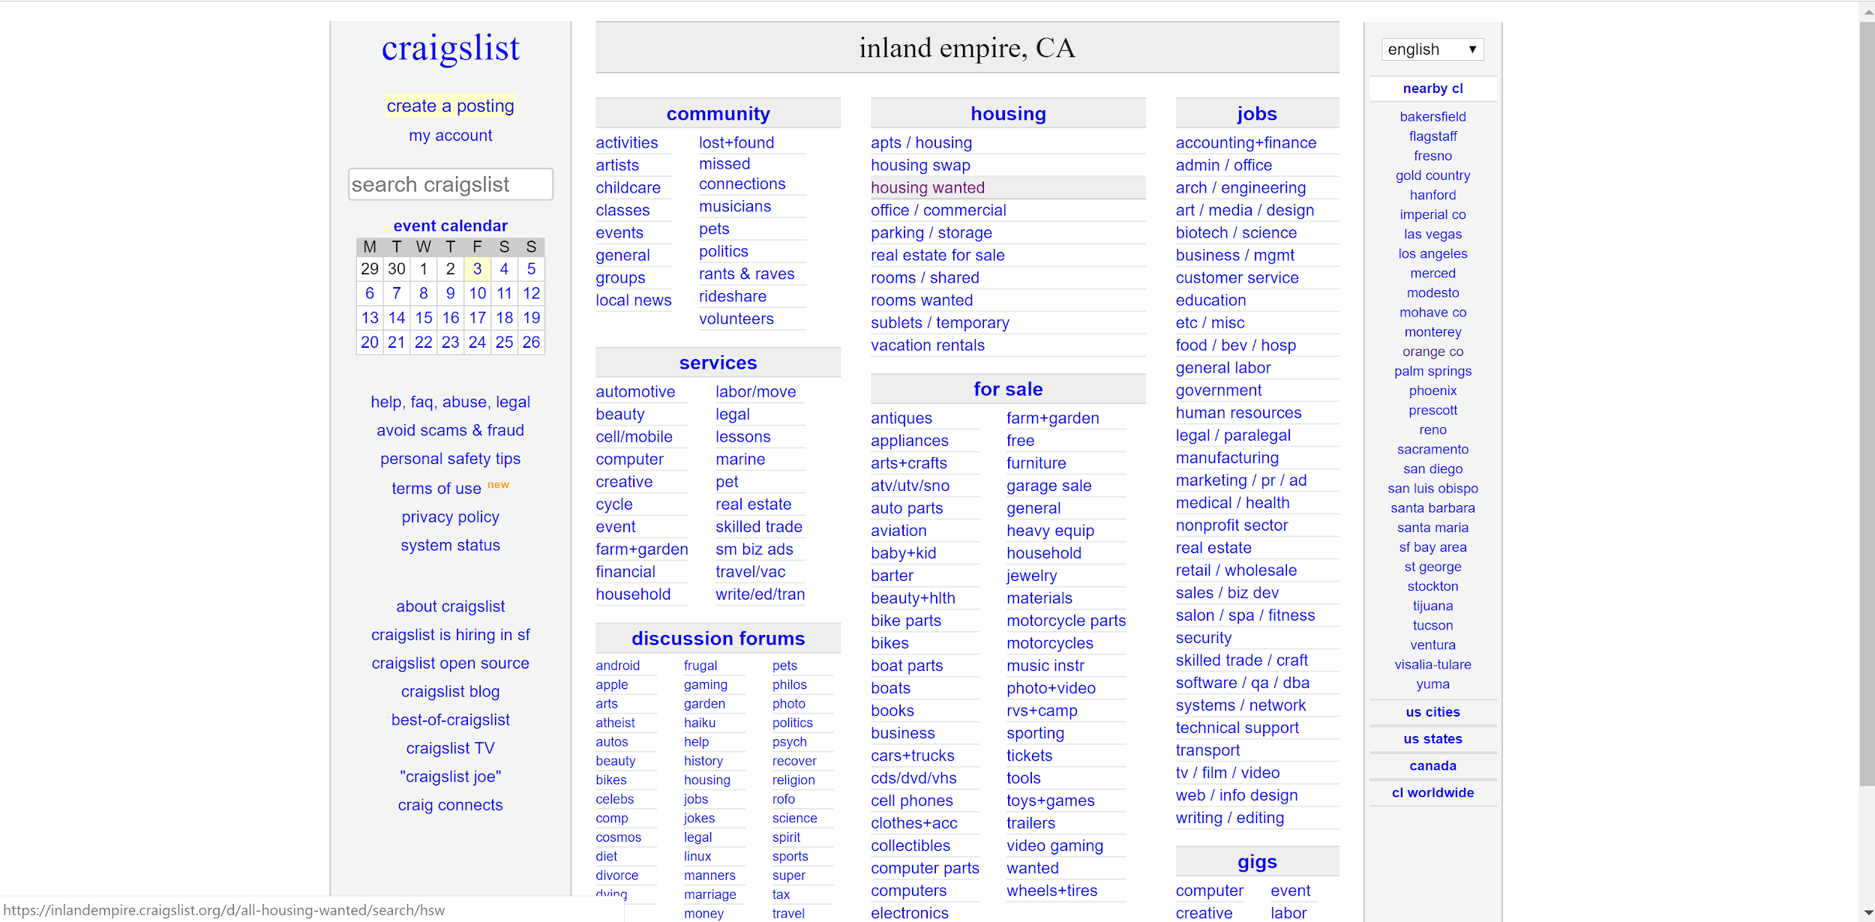

Slide 4
Schneiderman’s 8 Golden Rules
Consistency
Naming convention - cl vs craigslist throughout the site
inconsistency in grouping categories
Prevent Errors
Links throughout site are clustered, allowing users to click on wrong link
Universal Usability
First time users overwhelmed by clustered links
No resource on how to navigate site (help menu not clearly visible)
No reward for returning users (no shortcuts)
Internal Locus of Control
interface is very cluttered/overwhelming

Slide 5
Don Norman’s Principles of Design
Mapping
There is no way to easily navigate across categories, there are too many of them
In the new design, we created a series of drop down menus (combo box) to more easily navigate the site
Signifier (next slide)

Slide 6
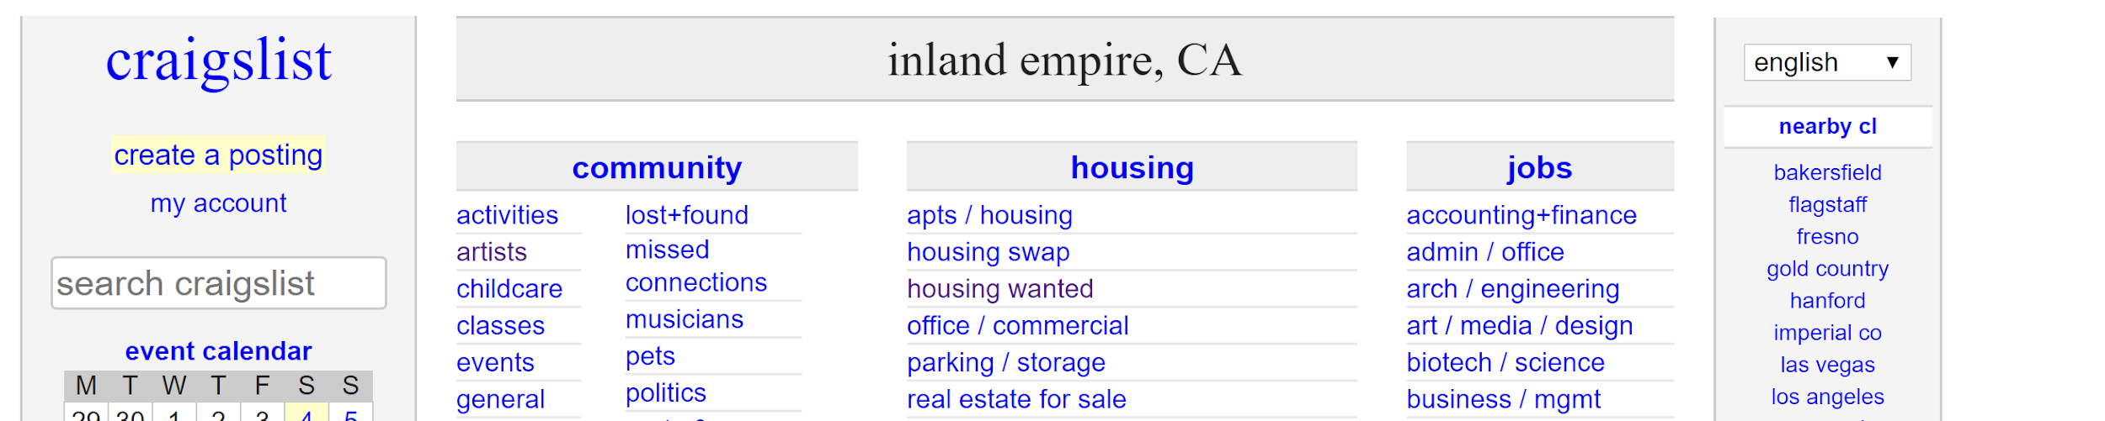
Example of Bad Signifiers

Slide 7
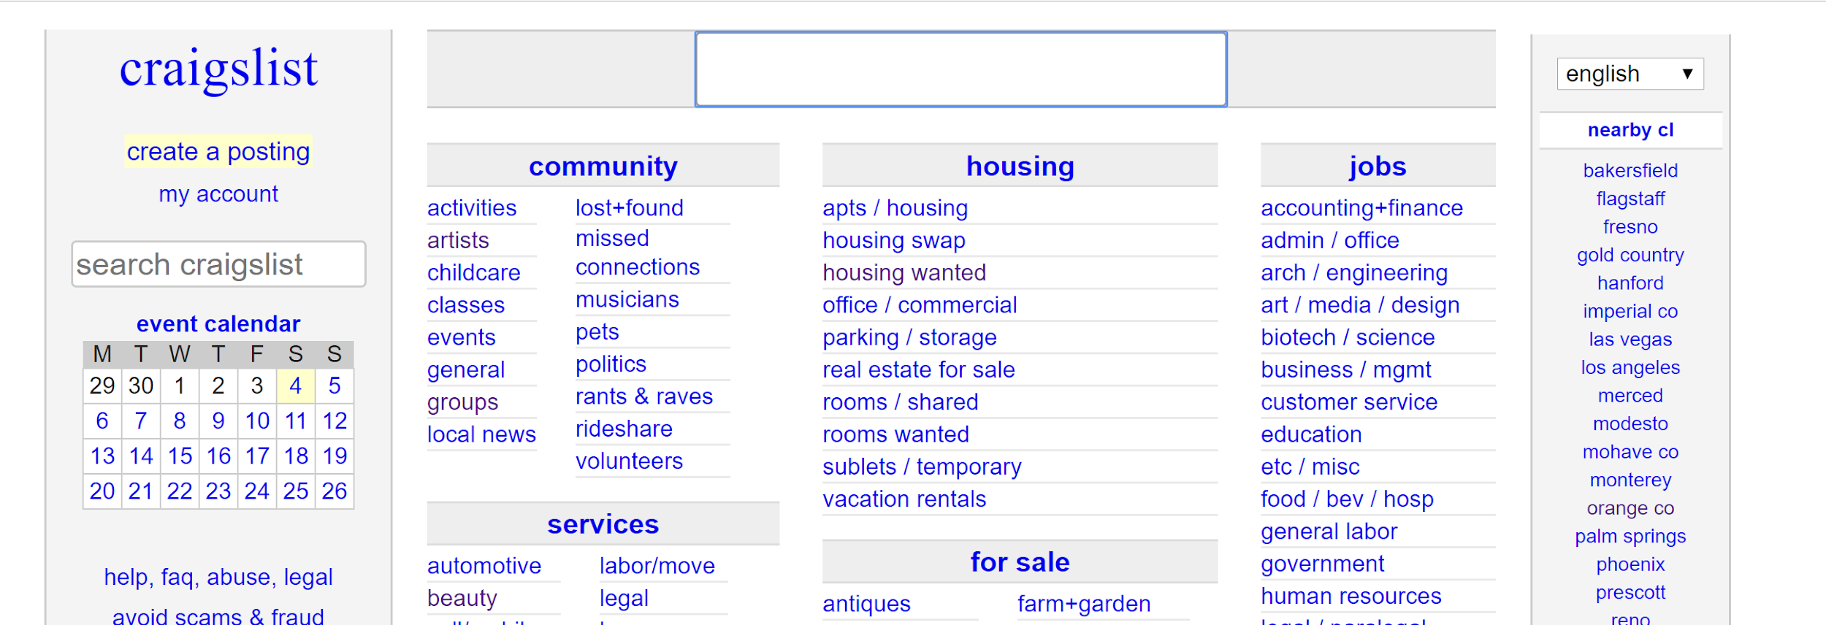

Slide 8
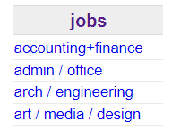
Visual Design
Proximity
Grouping of items are inconsistent in terms of
Font size
Abbreviations
Number of columns
Similarities
Categories contain overlapping items from other categories
Continuity
Categories are not aligned (no horizontal continuity)
Categories end at different lengths
Contrast
Font size between categories and sub-categories too similar

Slide 9
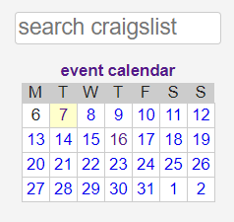
Evaluation
Difficult for new users to navigate website
Most use search bar, but no emphasis on feature
Calendar
events only small part of craigslist, but calendar on front page

Slide 10
Adherences
Color of the clickable elements of the site remains the same
website is either white, blue, or purple
Grouping helps slightly
the categories are organized even though it doesn’t look pretty
The links provide their proper affordances
they navigate the user to a specific page
Links provide feedback when hovered over or clicked
Reversal of action is possible

Slide 11
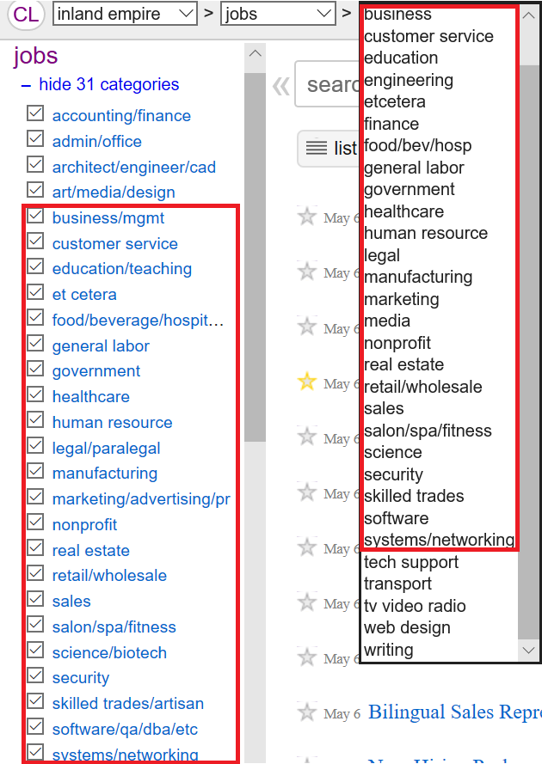
Nielsen Heuristics
[H-8 Minimalist design] [severity - medium]: The original craigslist website often included too many/duplicate options in their searching interface.
Example: The subcategories are shown as a search option twice in this interface.
We incorporated the posts into the home page to avoid this.

Slide 12
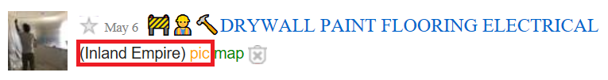
Nielsen Heuristics
[H-8 Minimalist design] [severity - small]: Additionally, the posts on the original included information that was not needed.
Example: The descriptions of the posts lists information that is already known.
These options were removed since there was no point in having them listed in the first place.

